Slide 1


Simulating Yukawa Interactions on Qubit-Qumode Hybrid Devices
Dr Ross Jenkinson
LHCQC Workshop – 23/09/2026

Slide 2
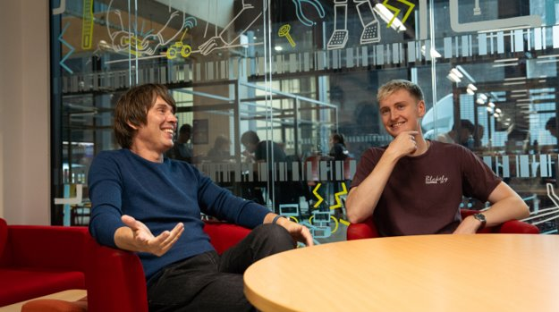
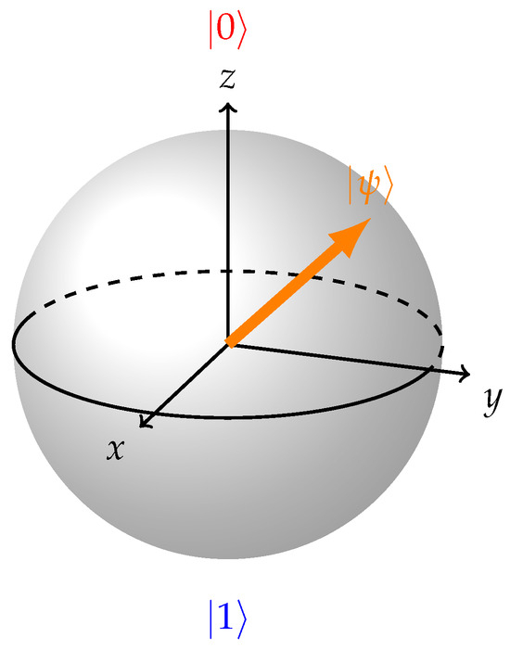
Who Am I?
2017 – 2021: Oxford (MPhys)​
2021 – 2025: Manchester (PhD)​
2026 – Now: Manchester (Postdoc)​

Slide 3

Who Am I?
2017 – 2021: Oxford (MPhys)​
2021 – 2025: Manchester (PhD)​
2026 – Now: Manchester (Postdoc)​
22nd Sept 2026 10:30 – 22nd Sept 2026 12:30:
LHCQC Workshop 2026 Blooket Quiz Champion

Slide 4
LHC uses for Quantum Computing
Analysing data
Quantum Machine Learning
Detector simulation
Many more…
Simulating the theories themselves from the ground up

Slide 5
Why simulate QFTs?
Probe features of a theory without spending billions of euros on colliders (e.g. €16.5 billion for FCC...)
Test toy models rather than reality
Simulate features that are as-yet not understood
  e.g., Lattice QCD can calculate the proton mass to ~1%, but
  cannot tackle hadronisation, parton showers from first principles, thermalisation in heavy-ion collisions, etc.

Slide 6


Can classical computers simulate QFTs?
There are multiple ways to solve QFT problems:
Hamiltonian formalism:
Uses unitary operators and evolves a quantum state in real time
Path integral formalism:
Can interpret the integrand as a probability distribution and treat the QFT analogously to statistical mechanics, using Monte Carlo techniques to sample the infinite integral

Slide 7
Can classical computers simulate QFTs?
The problem with continuum QFT: Infinite degrees of freedom (how do we simulate?)
The problem with perturbative QFT: Only works well for small coupling or small times
Usual solution: Lattice QFT
i.e., Discretise space -> Finite degrees of freedom -> evaluate integral numerically -> no need for coupling expansion (also provides UV cutoff)

Slide 8
Can classical computers simulate QFTs?
Problem with Hamiltonian formalism:
The complexity of representing the evolving state classically grows exponentially, and the Hilbert space is exponential in N (number of lattice sites)
Problem with path integral formalism:
Lorentzian signature: wildly oscillating phase (‘sign problem’)
-> Monte Carlo techniques fail
or Euclidean signature: no real-time dynamics
If only there was a device that utilised exponentially large Hilbert spaces and could easily apply unitary operators………

Slide 9
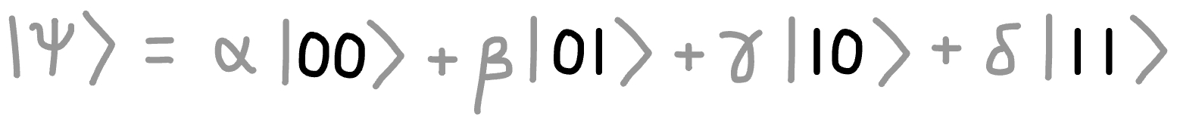
Quantum Computing
Classical computing uses bits, 0 and 1
Quantum computing uses quantum bits (“qubits”), which can exist in a superposition of 0 and 1 simultaneously
Dimension of the Hilbert space is exponential in N (number of qubits)

Slide 10
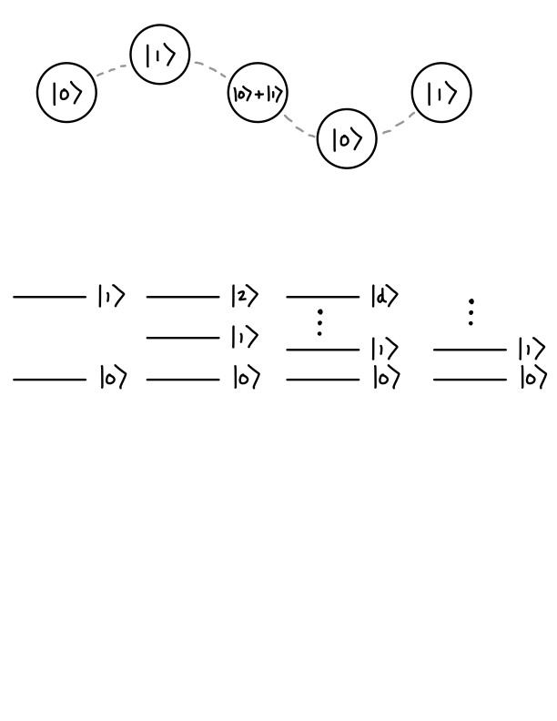
Quantum Computing
Qubits
two energy levels

Slide 11
Quantum Computing
Qubits
two energy levels
Qutrits
three energy levels

Slide 12
Quantum Computing
Qubits
two energy levels
Qutrits
three energy levels
Qudits
D energy levels

Slide 13
Quantum Computing
Qubits
two energy levels
Qutrits
three energy levels
Qudits
D energy levels
Qumodes
infinite energy levels

Slide 14
Quantum Computing
Qubits
two energy levels
Qutrits
three energy levels
Qudits
D energy levels
Qumodes
infinite energy levels
quantum harmonic oscillator

Slide 15
Simulating fields
Fermions:
  Occupation number of a single field mode = {0, 1}
  Two-state objects -> Qubits are the natural choice
Bosons:
  Occupation number of a single field mode = {0, 1, …, inf}
  Qubits would require truncation -> Qumodes are the natural choice

Slide 16




Continuous-Variable Quantum Computing
QHO has infinite energy levels:
Quadrature variables have continuous eigenvalues, this is where information is stored and manipulated in a CVQC
Great for QFT, where each field mode is modelled as its own harmonic oscillator -> One qumode per spatial lattice site
We can manipulate this continuous variable with single operators (e.g., the displacement gate) rather than shifting many energy levels simulataneously

Slide 17
Continuous-Variable Quantum Computing
Physical realisation:
  Photonic: long coherence times, room temperature, no non-Gaussian gates
  Transmon cavity (circuit QED): fast, less tunable
  Ion chains: long motional coherence, can also encode fermions

Slide 18













The Simulation Recipe
1
Write down the Hamiltonian.
2
Map the system onto qubits/qumodes.
3
Write H in terms of QC operators.
4
Prepare the starting state.
5
Evolve in time, in small steps.
6
Measure and repeat.
Notes:
TIMING about 30 seconds. Here is the whole recipe on one page. Six steps, and they are the same for every system in physics. The idea that you would even want to do this goes back to Feynman in 1982, and Lloyd made it concrete in 1996 by showing that any local Hamiltonian can be simulated efficiently with gates. We will now take the six steps one at a time, each with a picture.

Slide 19
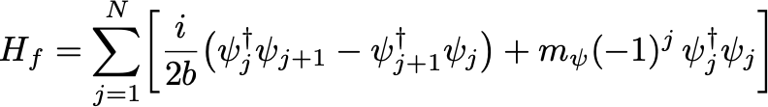
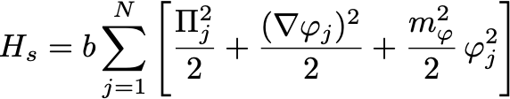
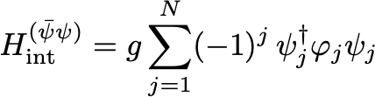
Example: Yukawa Interaction

Slide 20
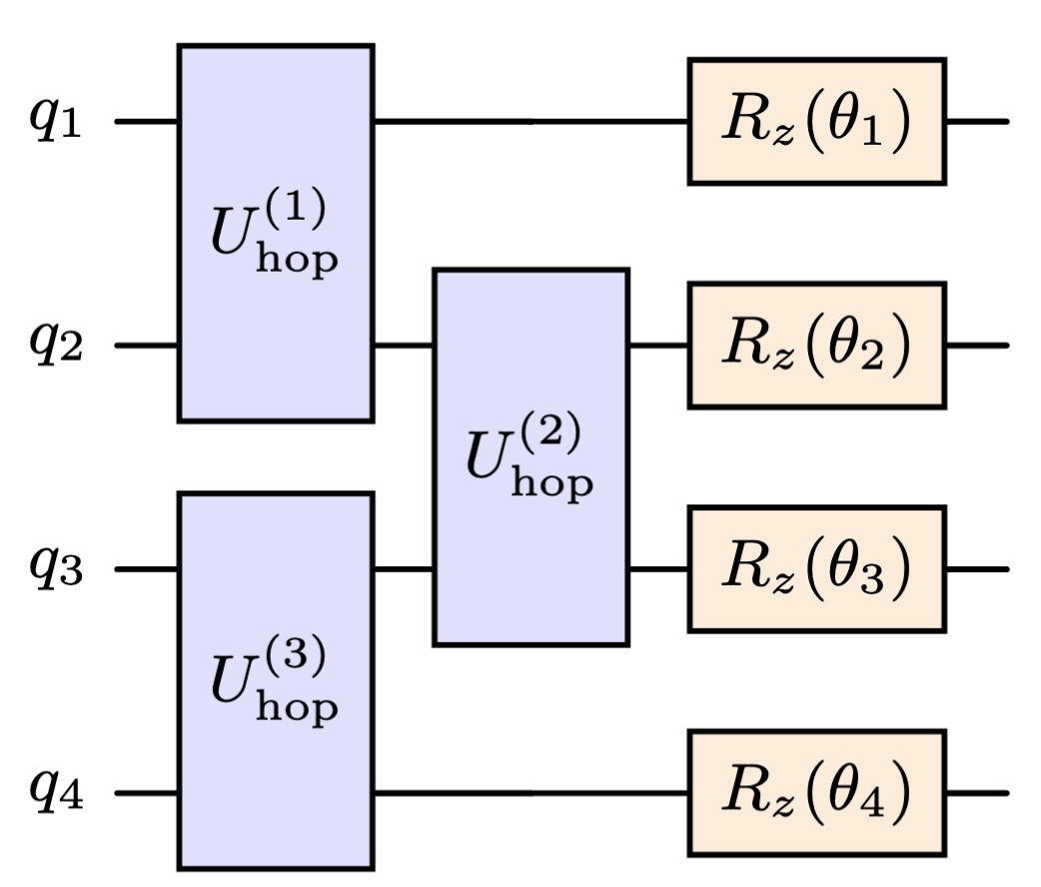


Fermion unitary

Slide 21
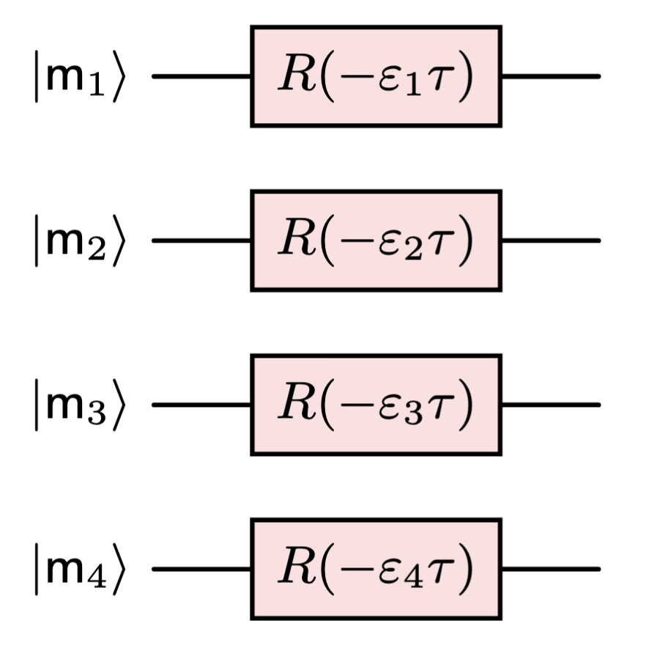
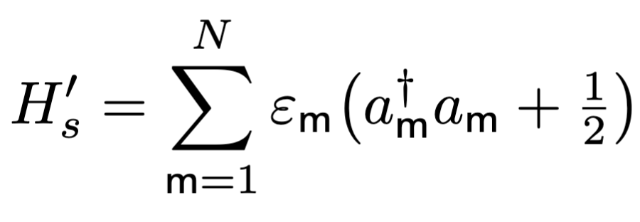

Boson unitary

Slide 22
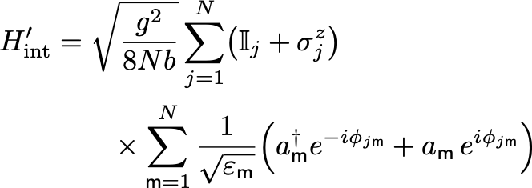

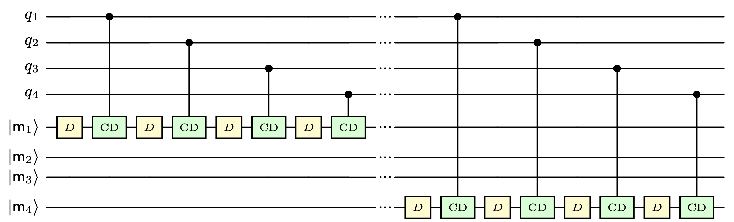
Interaction unitary

Slide 23
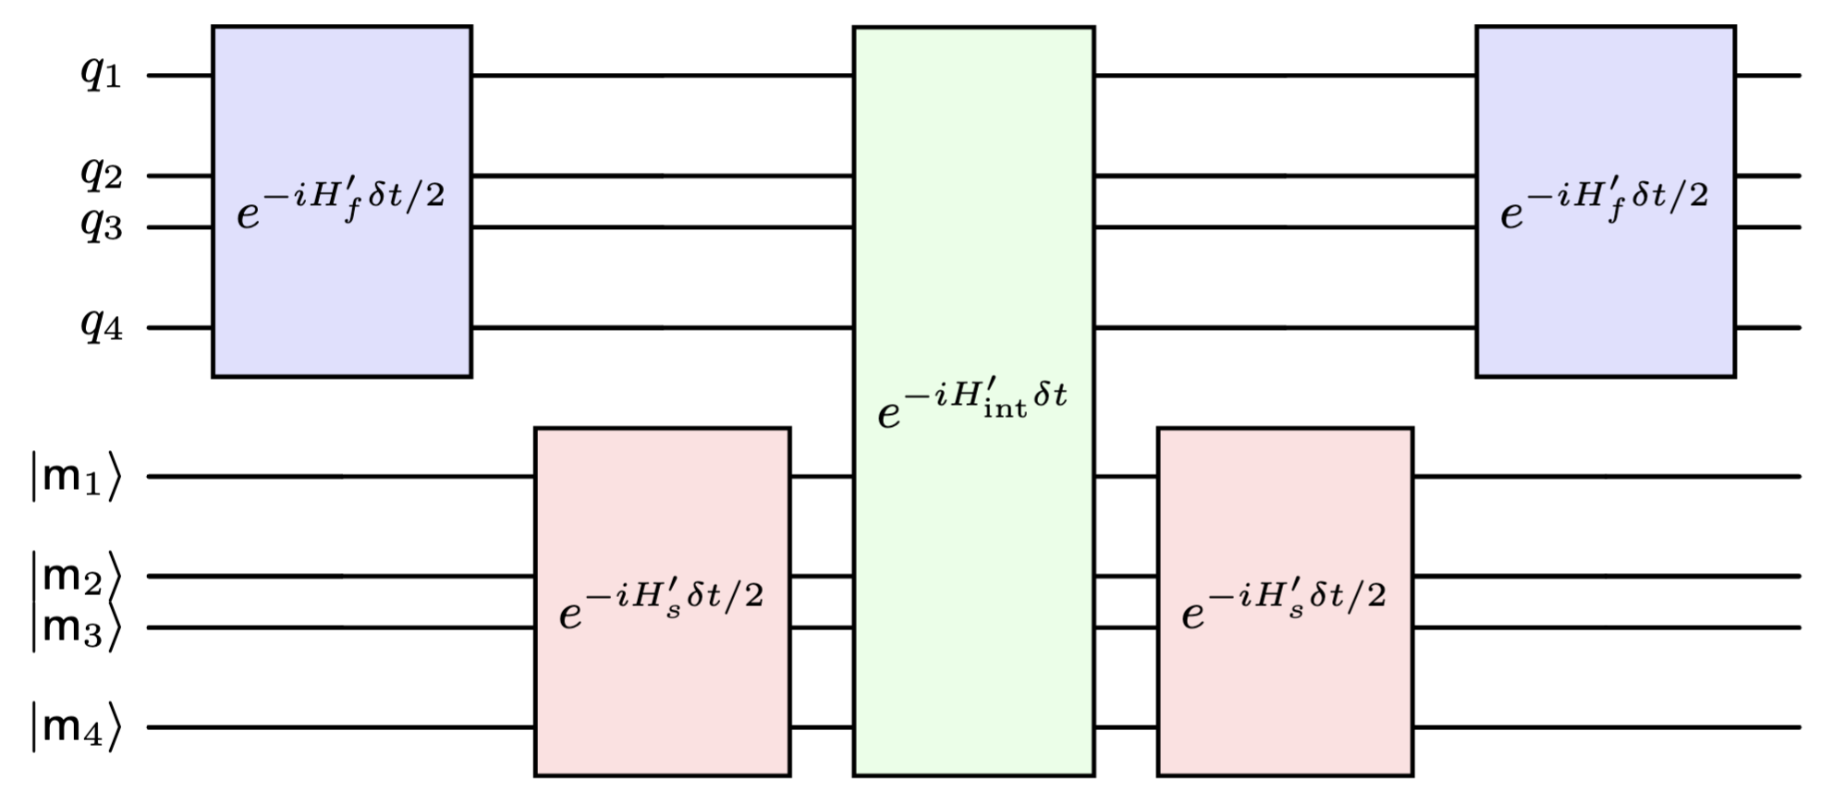
Example: Yukawa Interaction

Slide 24
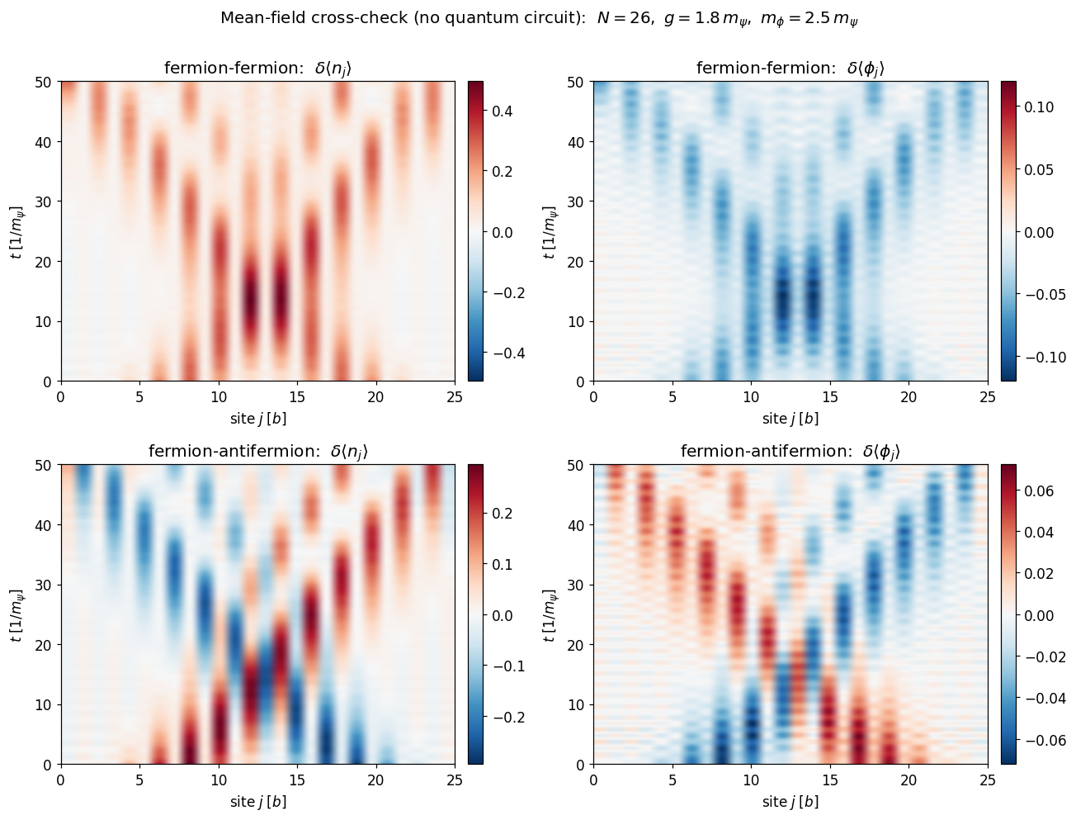
Example: Yukawa Interaction

Slide 25
Research Landscape
Real-time scattering processes with continuous-variable quantum computers; Abel, Spannowsky, Williams; 2025.
https://doi.org/10.1103/q36d-w649
Simulating quantum field theories on near-term quantum devices; Simon Williams; 2025.
https://doi.org/10.1142/S0217751X25300108
Quantum simulation of scattering amplitudes and interferences in perturbative QCD; Chawdhry, Pellen, Williams; 2025.
arXiv:2507.07194
Real-Time Scattering in Ising Field Theory using Matrix Product States; Jha et. al; 2024.
https://doi.org/10.1103/9dxz-k5wb
Fermionic wave packet scattering: a quantum computing approach; Chai et. al; 2025.
https://doi.org/10.22331/q-2025-02-19-1638

Slide 26
Summary
Quantum computers are the natural machines to simulate quantum field theories
There are more options than just qubits (e.g., qumodes are perhaps better suited for bosons)
If a system can be described by a Hamiltonian, then the process is reasonably formulaic
We can probe quantum systems as they evolve in real time

